Slide 1
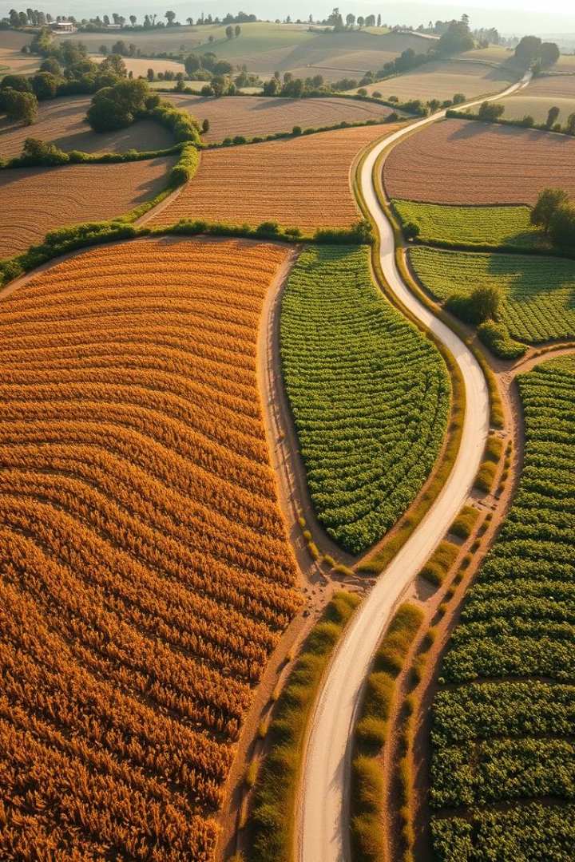
Agribasket
Fresh, Organic Vegetables Delivered to Your Door
Introducing Agribasket: Our solution for local organic produce. We deliver farm-fresh vegetables directly to consumers. Our goal is building a healthier, more sustainable food system for all.It is a online platform that directly connects organic farmers to customers.
Presented by: Jashanpreet kaur
Date: 8April2025

Slide 2
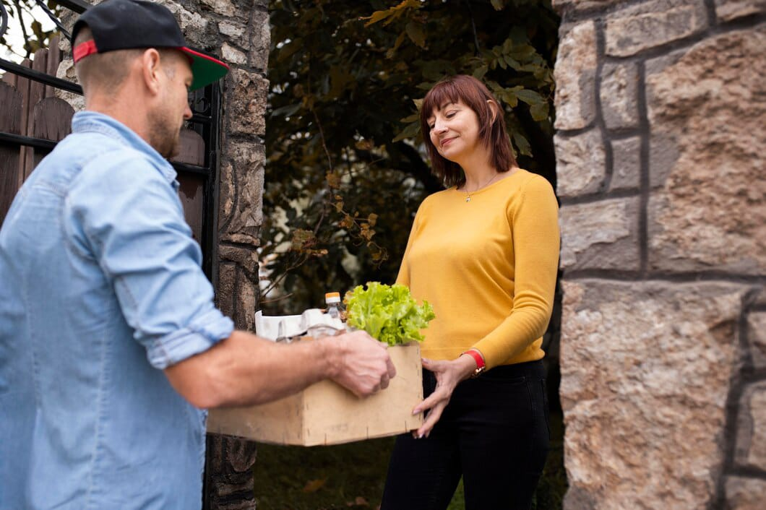
Overview –
Agribasket is an e-commerce platform for fresh organic vegetables and fruits delivery.
Connects customers directly with local organic farmers.
Solves the problem of limited organic availability and high prices.
Provides affordable, fresh, and chemical-free produce at the customer’s doorstep.
Encourages sustainable farming and supports local farmers.
Fast and reliable delivery service through a user-friendly mobile app.
Transparent sourcing and quality assurance.
Focus on expanding to urban and semi-urban markets.
High growth potential due to increasing demand for healthy organic food.
Future plan includes adding groceries, dairy products & subscription-based models.

Slide 3
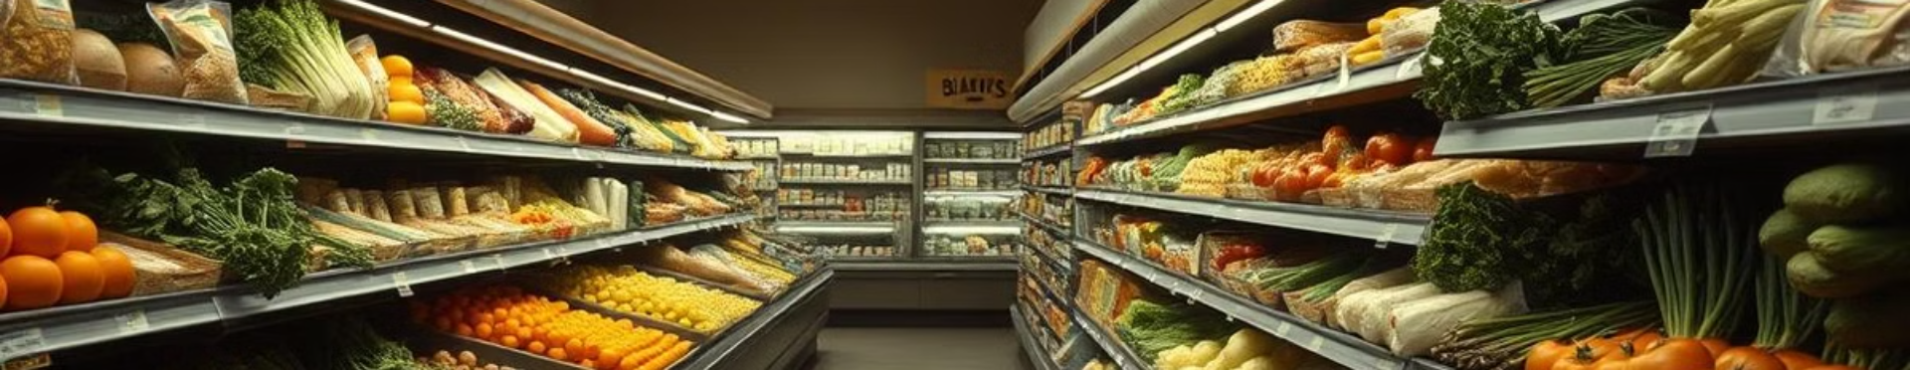

The Problem: Access to Fresh, Organic Produce
Limited organic options in many areas lead to high prices. Inconvenient shopping experiences and lack of transparency exist. Only 2% of Indian farmland is organic. The average family spends 2500-4000 per month on groceries.
Lack of Affordable & Trustworthy Organic Vegetables in India“
• Consumers struggle to find fresh, affordable, and verified organic vegetables.
• Organic products available in markets are often expensive and limited in variety.
• Customers face trust issues regarding the authenticity of organic produce.
• Organic farmers have limited access to the right market to sell directly to customers.
• Middlemen reduce farmers' profits and increase prices for consumers.

Slide 4
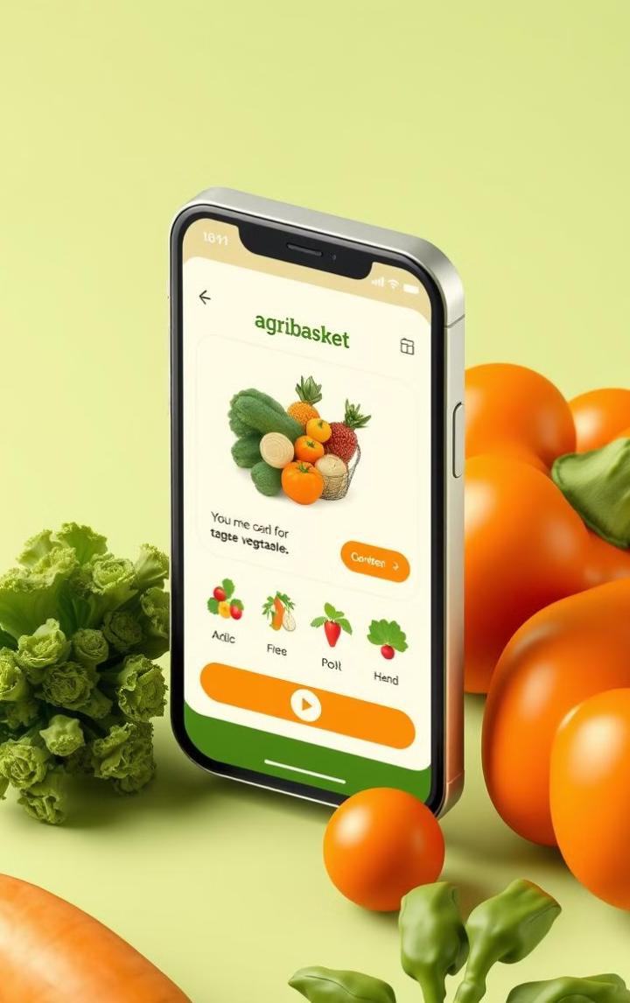
Our Solution: Agribasket - The Organic Vegetable Delivery App
Agribasket - Bridging the Gap between Organic Farmers and Consumers“.
A dedicated e-commerce platform & mobile app for organic vegetables.
Direct connection between certified organic farmers and consumers.
Affordable pricing by eliminating middlemen.
Transparent sourcing with farmer details & product authenticity.
Easy doorstep delivery of fresh organic produce
Empowering local farmers with fair prices and market access.
Focus on promoting healthy living with organic eating habits.

Slide 5
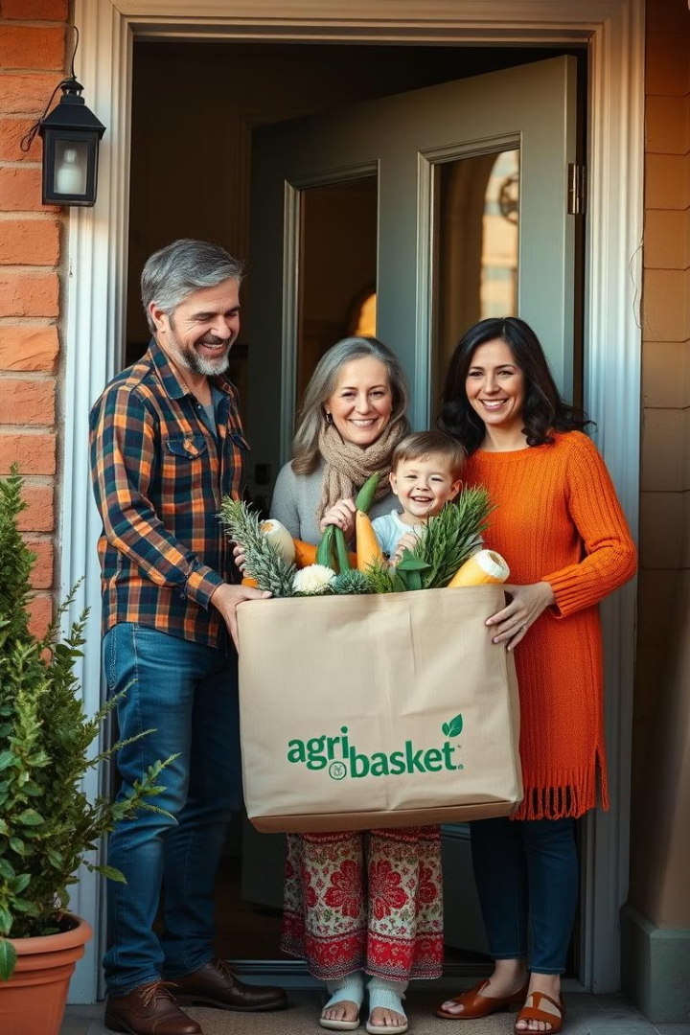
Unique Approach
• A Dedicated Platform Exclusively for Organic Products
(Unlike general grocery apps mixing organic & non-organic)
• Connecting Directly Farmers to Customers
(Eliminating middlemen & ensuring fair pricing)
Real-Time Traceability of Every Product
(Customers can see where, who, and how their food was grown)
• Customized Organic Basket Subscription
(Auto-delivery based on userpreference weekly or monthly)
• Affordable Organic Produce at Doorstep
(Farm fresh, verified quality & reasonable pricing)

Slide 6
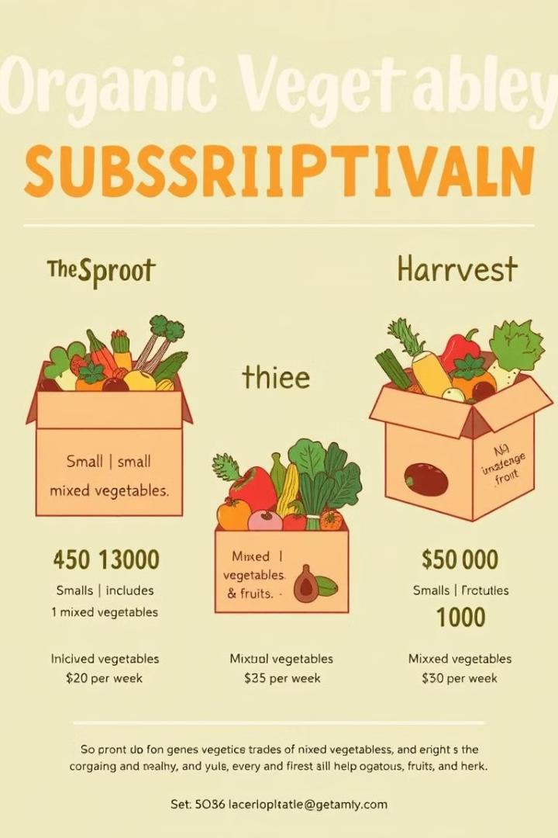
Business Model: Subscription-Based Delivery
We Offer weekly or bi-weekly subscription options. Tiered pricing is based on basket size and contents.
Like a small basket having 6-8 veggies-upto 400rupees.
Medium basket 8-12 vegetables+ fruits-800rupees.
Large Baskets 15+vegitables and fruits -1200rupees.

Slide 7

# Market Opportunity: Growing Demand for Organic Food
The organic food market is projected to reach $67B by 2024. Consumer awareness of health is increasing. Untapped market potential in cities exists. Organic produce sales are growing at 15% annually.
—
- Projected market by 2024. - Annual growth rate

Slide 8
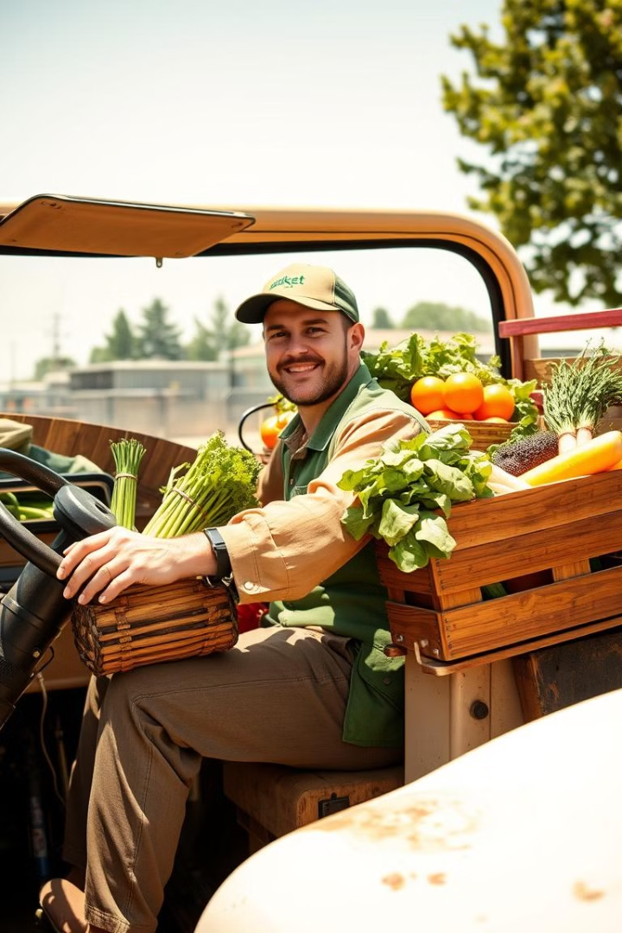
How Will I Make Money?
1. Subscription Model:
• Customers will subscribe for weekly or monthly vegetable & fruit baskets.
• Fixed recurring income.
2. Direct Sales
• Customers can order products without a subscription.
• Available on-demand through the app or website
.• Includes seasonal & premium organic products.
3. Add-on Sales
• Selling additional organic items like:
Dairy products
Organic pulses & grains
Homemade pickles, juices, health drinks
• Partner with local organic farms & home businesses.
Cash Burn Reasons:
Delivery & Logistics - Packaging, transportation, and last-mile delivery costs.
Marketing & Customer Acquisition Discounts, advertisements, and promotional
campaigns to attract new users.

Slide 9

Total Market Size: Organic food & vegetable market in India - ₹10,000+ Crores (Growing 20% YoY)
Target Market Share:
• Targeting 2-3% of urban health-conscious consumers initially.
Customer Profile:
• Age Group: 25 to 45 years
• Location: Tier-1 & Tier-2 cities (Starting from Punjab & Chandigarh)
• Purchase Habits: Prefer online shopping, subscription-based models, looking for chemical-free & organic products
• Personal Traits: Health conscious, working professionals, fitness lovers, young families
Marketing Channels to Reach Customers:
• Social Media Ads (Instagram, Facebook, YouTube)
• Google Ads (Search + Display)
• Offline Promotion (Local events, community tie-ups)
• App Referral Program & Loyalty Rewards

Slide 10

How Agribasket Adds Value:
• Customers get 100% Organic & Fresh Vegetables directly from farms.
• Affordable prices because we remove middlemen.
• Easy to order from Mobile App anytime.
• Fast & Same-Day Delivery in local areas.
• Subscription Plans for daily & weekly deliveries.
• Transparent Sourcing Customers can see where their food is coming from.
• Supporting local farmers by giving them fair prices.
"It's like having your own personal organic farm at home - without growing it!"

